Slide 1
Infection Propagation Problem
Team #10
Harsh Agarwal – 181IT117
Naman Vijayvargiya – 181IT129
Raj Kishore Sethi – 181IT136
Shraddha Gole – 181IT145

Slide 2
Outline
Problem Definition
Problem Formulation
Sample Problem Illustration
Approaches
Results
Limitations
Future Work

Slide 3
Problem Definition
A network of connected computers
Infection starts with 1 computer and can propagate only if there is a connection between the 2 computers
Infection cannot propagate via a safe computer
Protector can mark any one computer as a safe computer by shutting it down
The infection ends when no more nodes can be infected or the protector cannot mark any more computers as safe
Goal is to minimize the the number of infected nodes

Slide 4
Problem Formulation
The problem is formulated as a 2 player graph game.
Each computer is a node and each connection is an edge.
The infection can choose any one node to infect from the neighbours of the already infected nodes which are not safe
The protector can choose any one node which is neither safe or infected to save.
Each player will select only one node at a time

Slide 5
Sample Problem
 | Infected
 | Safe
 | Available

Slide 6
Greedy Algorithm
  The next node to be saved should be the the node with maximum number of adjacent nodes.
  This approach is not optimal
  In worst case will infect N/2 nodes

Slide 7
Generating the Pruned Graph
From the start of the infection the infection will reach a particular node in at least n steps where n is its shortest distance from that node
If there are K nodes at depth M and if K< M we do not need to consider the nodes after depth M

Slide 8
MiniMax Algorithm
MiniMax Tree is generated from the graph
A leaf nodes is given the value of it’s depth
Every path from the root to a leaf node will define strategy
The protector is trying to minimize the the length of this path and the attacker is maximizing the same

Slide 9
Alpha Beta Pruning
It stops completely evaluating a move when at least one possibility has been found that proves the move to be worse than a previously examined move.
The algorithm maintains two values:
  Alpha - the minimum score for max. Player
  Beta - the maximum score for min. player
Initially Alpha is -inf. and Beta is +inf.

Slide 10
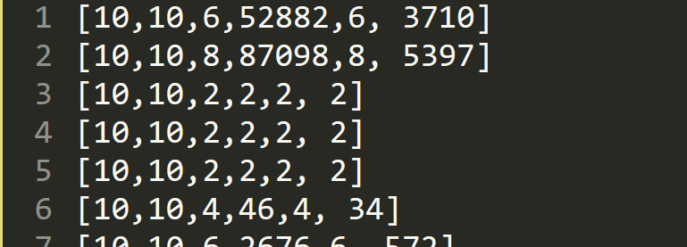
Results and Analysis
[number of vertices, number of edges, rank using minimax algo, nodes visited using minimax algo, rank using minimax_ab_pruning, nodes visited using minimax_a_b_pruning]

Slide 11
Results and Analysis
We infer from the obtained results that both the Algorithms are giving the correct outputs and the number of nodes visited by Minimax using alpha beta is less than Minimax without using alpha beta.
Therefore, the Minimax algorithm with alpha beta is more optimal.

Slide 12
Limitations
The current problem definition is very limited in scope as to the speed with which the infection is spreading and that the infection can only add one node at a time
The proposed algorithms works well for sparse graph but the efficiency decreases as the graph becomes more dense
Approximate approaches may not give the optimal solution but will definitely may be a lot quicker

Slide 13
Future Work
To expand the scope of the problem to include the functionality of multiple infected nodes at a time.
Enhance the efficiency of the Program for Dense Graphs.

Slide 14
Thanks!

